Slide 1

ABC PHARMACEUTICAL SALES ANALYSIS REPORT

Slide 2
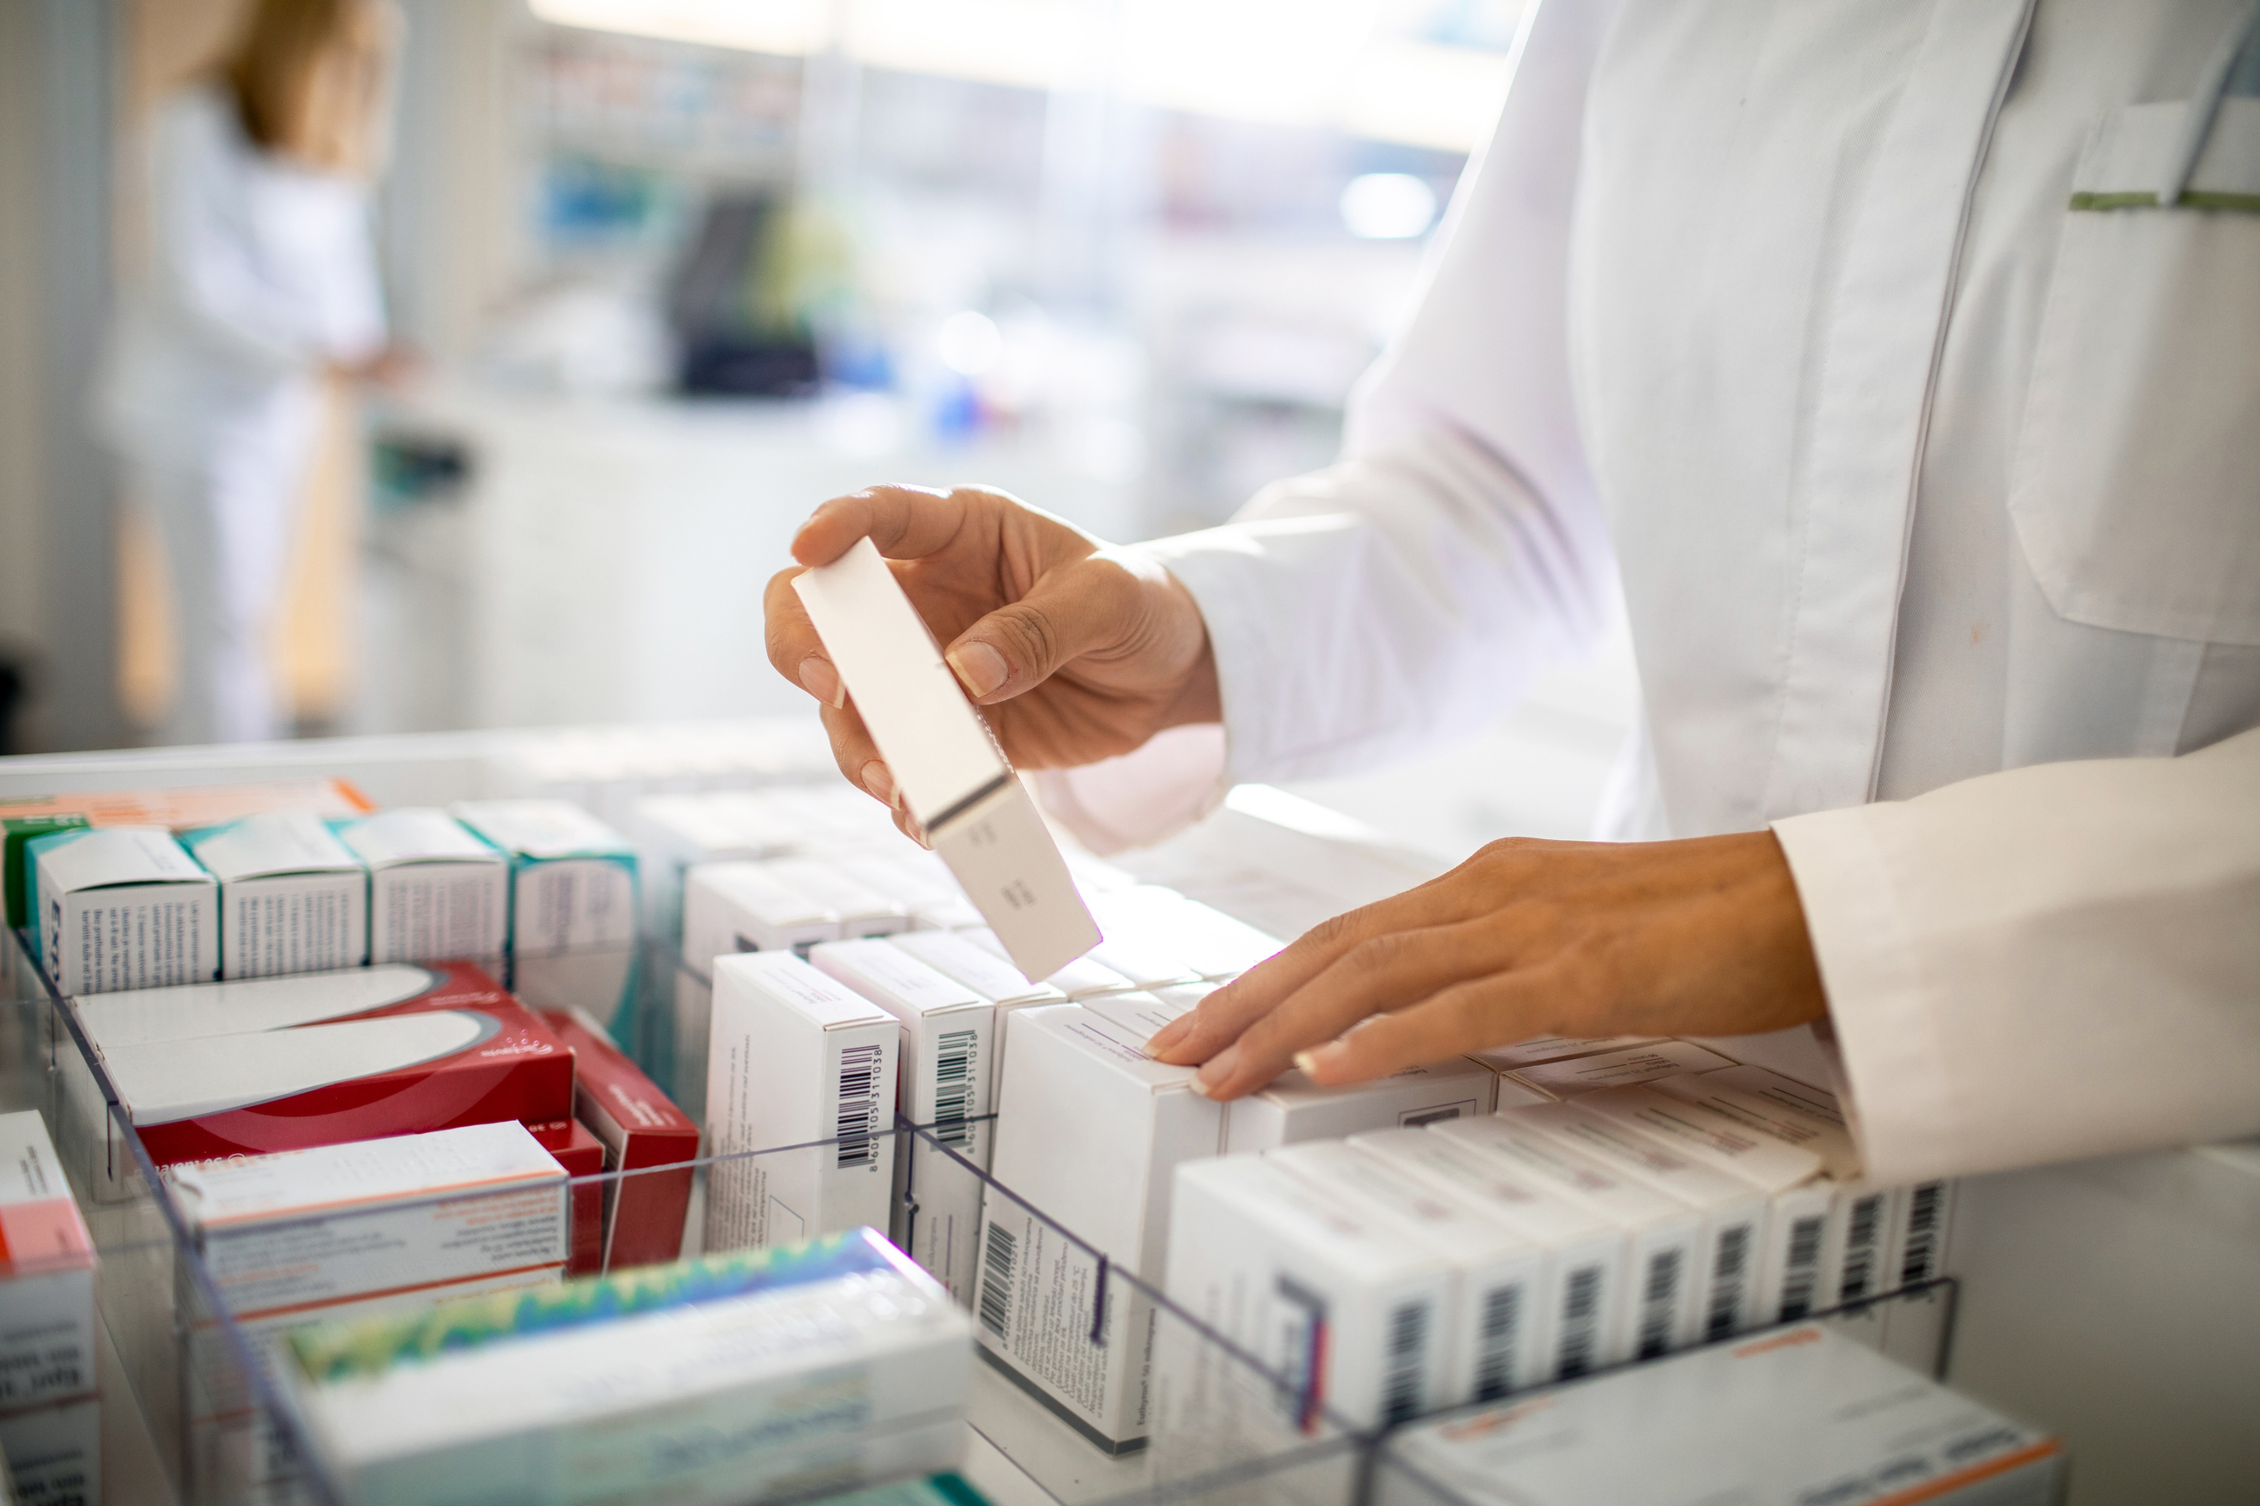
AGENDA
INTRODUCTION
DATA PREPARATION
INSIGHTS
KEY TAKEAWAYS
RECOMMENDATION

Slide 3
DATA PREPARATION
The data was provided by 3Signet and the tools used for this analysis are:
Excel
Python
Power BI
DB Browser (SQLite)
Data cleaning processes which includes removal of duplicates, outliers, in the dataset, categorizing the columns for easier analysis, was done on the dataset.

Slide 4
Problem statement
Sales performance variation among different customer channels
Sales variation by location in reference to population density and infrastructure.
Sales based on price and quantity

Slide 5
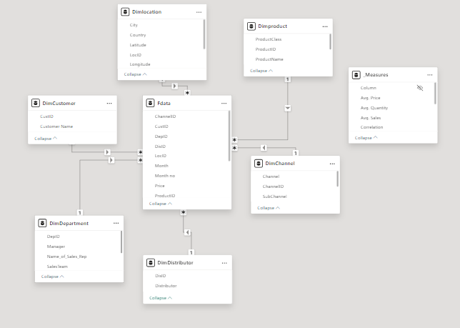
DATASET SCHEMA

Slide 6
Insights
The dataset contained over 245 thousand sales encounters, and it has a total revenue of 12billion(bn).
Between 2017-2020, the year with the highest sales is 2018 (3.5bn) and the lowest sales occurred in 2020 (2bn). The month with the highest sales collectively is November (1.1bn) and for the lowest sales, it is January (67m).
The top 3 product classes for each year by revenue are Analgesics (2.3bn), Antiseptics (2.2bn), and mood stabilizers (2bn).
Germany accounted for 11bn (94%) of the revenue while Poland had only 680million (6%) in revenue.
For Poland, sales was only recorded in 2018, November generating most revenue. The highest class of drugs sold is Antiseptics (6m) and mood stabilizers (2.6m).

Slide 7

iNSIGHTS

Slide 8
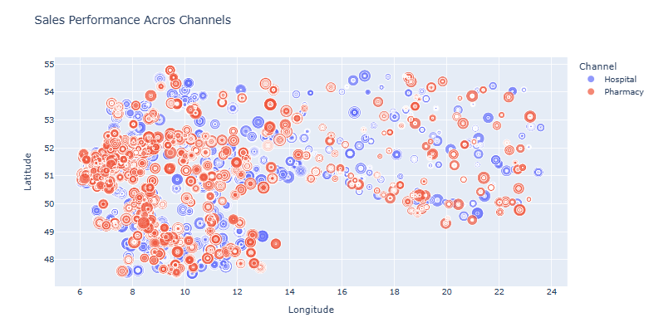
INSIGHTS

Slide 9
INSIGHTS

Slide 10
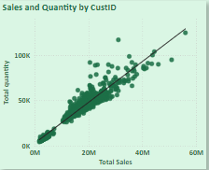
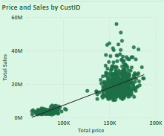
Statistical ANALYSIS
This shows a positive correlation between the quantity of products and sales.
There is also a positive correlation between the price of products and sales.

Slide 11
ANALYSIS ON PRODUCT, Subclass, LOCATION & MANAGER
Product Class | Subclass | Top Location(revenue) | Rural/Urban | Manager
Analgesics | Govt. Hospital | Altenburg (31m) | Urban | Brittany Bold
Antiseptics | Retail-Pharmacy | Ludwigshafen (21m) | Urban | Brittany Bold
Mood stabilizers | Retail-Pharmacy | Cuxhaven (33m) | Semi-Urban | Brittany Bold
Antipyretics | Retail-Pharmacy | Bottrop (31m) | Urban | Brittany Bold
Antibiotics | Retail-Pharmacy | Springe (20m) | Rural | Brittany Bold
Antimalaria | Govt-Hospital | Castrop-Rauxel (31m) | Urban | Alisha Codwell

Slide 12
KEY TAKEAWAYS
Sales depends on location as it plays a huge role on the class of drugs largely purchased in that vicinity.
Channel of distribution has an impact on revenue as analysis has shown Pharmacy have the highest revenue as compared to Hospitals. The same way government hospitals generate higher revenue as compared to private (population is higher in government hospitals).
Also, 94% of revenue is from Germany with top cities being Altenburg, Cuxhaven and Freidberg.
The drug with the highest revenue is Sumanazole (113m) and the least is Ampheslox (2.6m).
Urban settlements accounts for majority of the top products in comparison to rural locations.

Slide 13
RECOMMENDATION
Leverage the data obtained on classes of drugs based on location during the distribution process. Antiseptics are highly purchased in Ludwigshafen as compared to Bottrop. Also, analgesics and antiseptics are common in urban areas. Distribution should be prioritized to these fast-moving locations as compared to the slow-moving ones.
Retail pharmacies and public hospitals should be the priority during distribution, a bulk of the revenue comes from both location.
Implement strategies by Brittany Bold and her team members, which account for the bulk of revenue made. Incentives can be given to Brittany Bold’s team to encourage them and motivate other managers and their team members to do better in their locations.

Slide 14

THANK YOU
Salamah Alawiye
salamahalawiye@gmail.com

